Slide 1
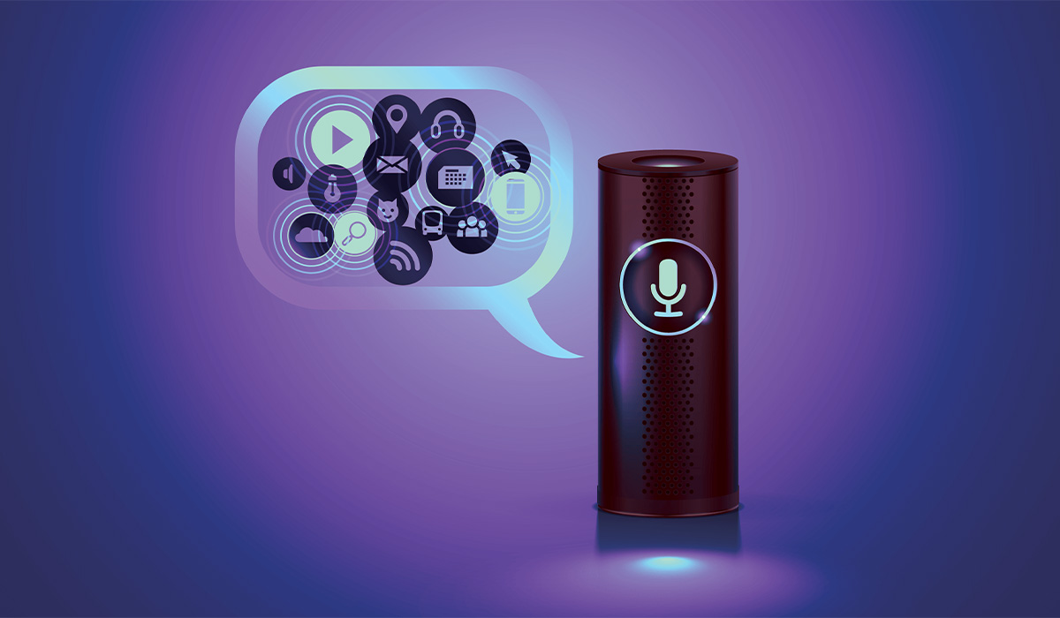
Voice-based Virtual Assistant for Windows
Naveen(RA2011042010086)
Srikanth (RA201102010088)
Chethan (RA2011042010093)
Lohith(RA201042010139)

Slide 2
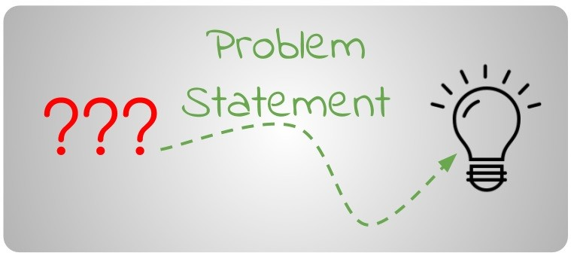
There is a need for a Voice-based Virtual Assistant for Windows that can assist users in performing these tasks seamlessly and efficiently. Such an assistant would enable users to execute commands through natural language voice commands, providing a more accessible and user-friendly interface for Windows users. This would not only increase productivity and efficiency but also enhance the overall user experience on the Windows platform.

Slide 3
OBJECTIVE AND TECHNIQUE
Objective: The objective of a Voice-based Virtual Assistant for Windows is to provide users with a more convenient and efficient way of interacting with their computer. The assistant should enable users to perform tasks using natural language voice commands, allowing for hands-free operation and reducing the time and effort required to navigate through menus and windows.
Technique: The development of a Voice-based Virtual Assistant for Windows requires the use of various techniques.

Slide 4
OBJECTIVE AND TECHNIQUE
1. Speech recognition: The assistant should be able to recognize and understand natural language voice commands from the user.
2.Natural language processing: The assistant should be able to interpret and understand the meaning behind user commands and respond appropriately.
3.Machine learning: The assistant should be able to learn from user interactions and improve its responses over time.

Slide 5
OBJECTIVE AND TECHNIQUE
4.Integration with Windows APIs: The assistant should be able to interact with various Windows APIs to perform tasks such as opening applications, setting reminders, and scheduling appointments
5.User interface design: The assistant should have a user-friendly interface that enables users to easily interact with it using voice commands.
By combining these techniques, a Voice-based Virtual Assistant for Windows can provide users with a seamless and efficient way of interacting with their computer, enhancing productivity and user experience.

Slide 6
Modules
Speech to Text: User will ask the computer to run command by giving input as speech
Command Execution: Based on command received from the user, system will execute the command (if available). e.g. Open Notepad, Paint, Google Chrome, etc. System accept various command such as opening of specific applications, writing a note and saving it, opening web URL, Search for any query or details and shutdown & Restart command
Text to Speech: Once a command is received, application speaks the command which make user experience more interactive with the system

Slide 7
Product lifecycle : waterfall model
The waterfall Model is a linear sequential flow. In which progress is seen as flowing steadily downwards (like a waterfall) through the phases of software implementation. This means that any phase in the development process begins only if the previous phase is complete. The waterfall approach does not define the process to go back to the previous phase to handle changes in requirement. The waterfall approach is the earliest approach that was used for software development.

Slide 8
Hardware and software requirements
i3 Processor Based Computer or higher
Memory: 1 GB
Hard Drive: 50 GB
Monitor
Internet Connection
Windows 7 or higher
Visual Studio
SQL Server
Google Chrome Browser

Slide 9
Advantages
It converts text to speech
It will assist you to find the applications easily.
It can be used in windows 7.
Limitation
Data need to be entered properly otherwise; outcome may won’t be accurate.
Application
This system can be used by the multiple peoples to get the counselling sessions online.

